Slide 1
Idea Presentation: Team Karve
Theme: Citizen Empowerment
Challenge: Detecting changing landscapes
Team : 20
By:
Rishita Ghosh
Venkat Maram
Vikash Chandra Singh
Vinit Dhamale
Aniruddh T.S
Bonny Dave

Slide 2
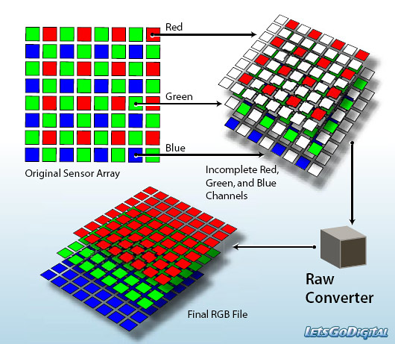
Selling your idea
Created a software algorithm to detect satellite image changes of landscape by image processing and analysing consecutive changes in the landscape and cropping techniques.

Slide 3


1. Intro
Technologies and softwares used:-
MATLAB Provide a simple unifying platform with inbuilt image processing techniques.
Web development using Eclipse,Adobe Dreamweaver High compatibility and user friendly
Simple Efficient and simple approach towards detection and data analysis.

Slide 4

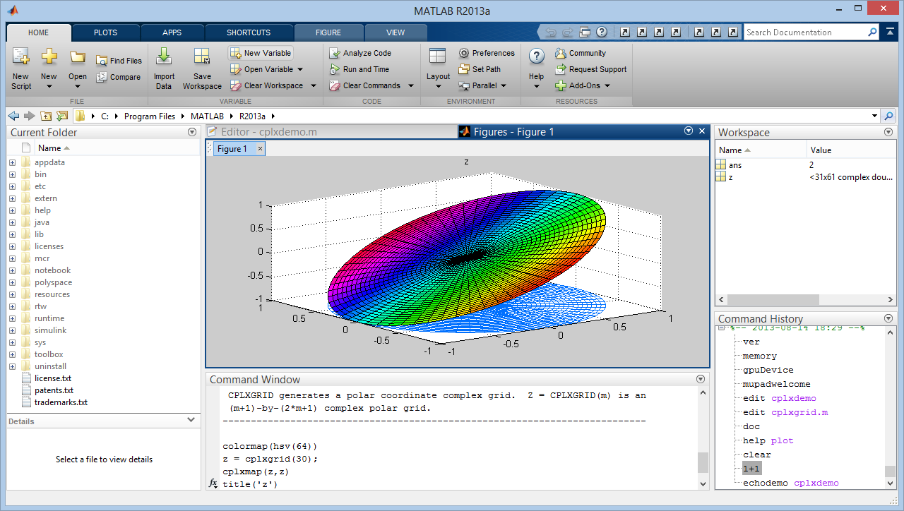
MATLAB

Slide 5
SATELLITE IMAGES
Image conversion to maps
Spectrum analysis and diversion into red, green and blue cover
Conversion of green space to grayscale
Create Histograms
Histogram 1
Histogram 2
Compare histograms
Output in graphical and numerical format

Slide 6
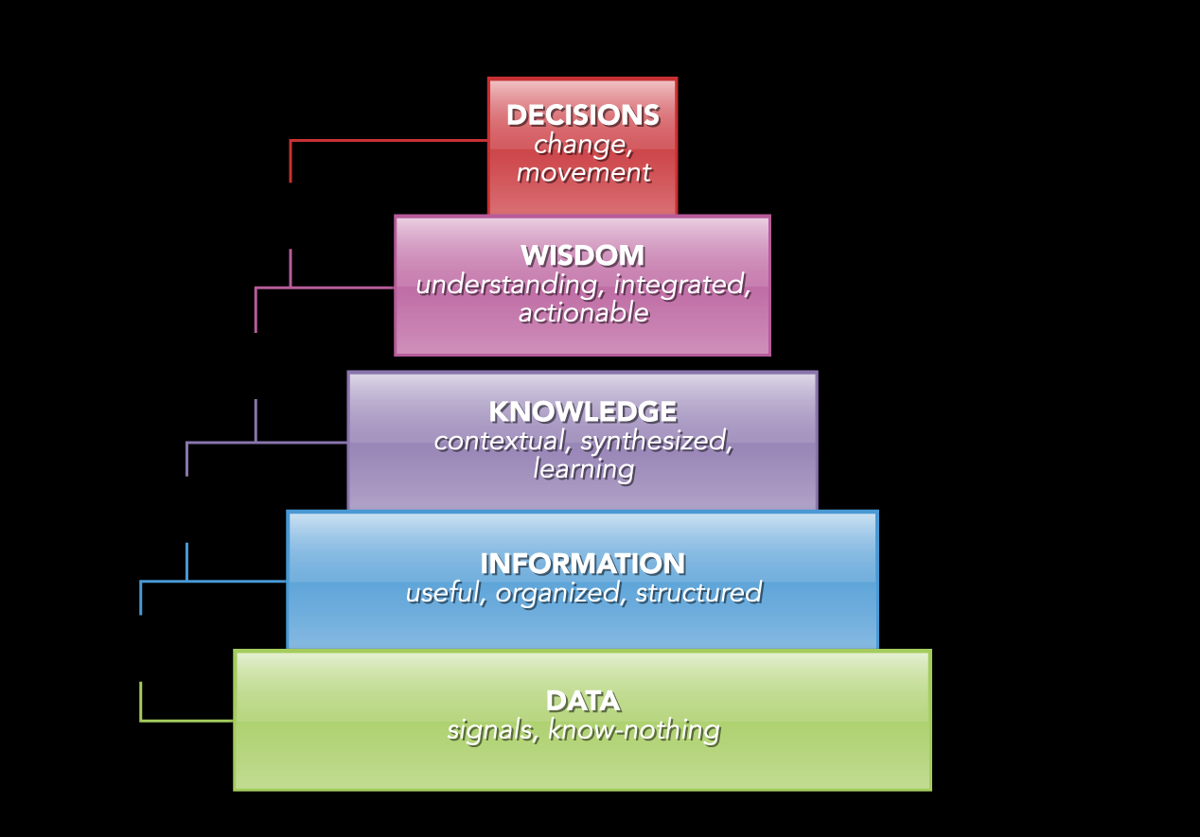
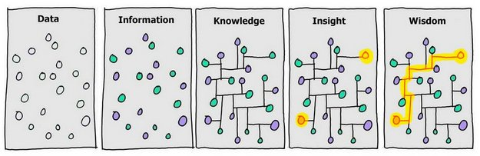
DIKW PYRAMID

Slide 7
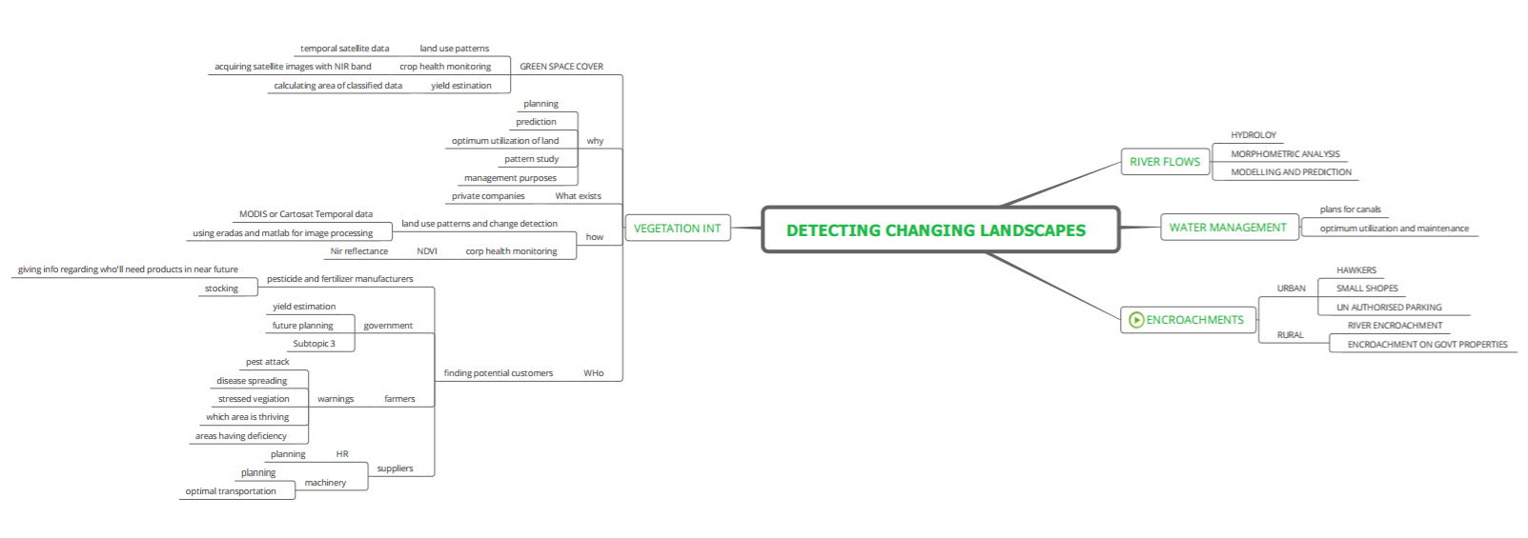

Slide 8
LULC, Vegetation Interpretation

Slide 9
LULC and Green Cover
Supervised classification
Unsupervised classification
Pattern detection
Calculate the area involved in each classes

Slide 10
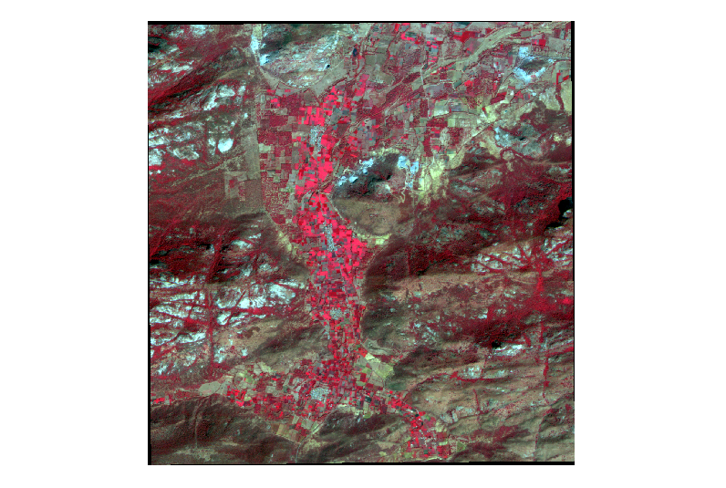
Unclassified data

Slide 11
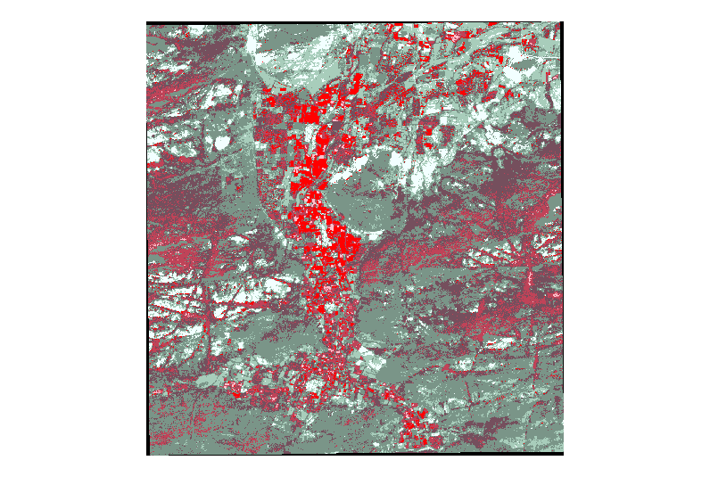
Classified data

Slide 12
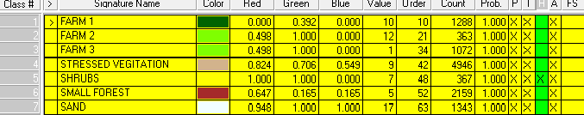
Signature File

Slide 13
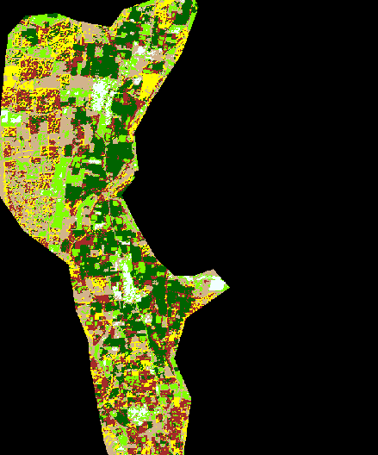
Subset

Slide 14
Vegetation Interpretation
Number of Pixels |  | Area sq m | %area
29003 | Unclassified | 725075 | 1.821665
207696 | FARM 3 | 5192400 | 13.04529
179529 | SMALL FOREST | 4488225 | 11.27613
336316 | SHRUBS | 8407900 | 21.12385
661599 | STRESSED VEGITATION | 16539975 | 41.55472
66112 | FARM 1 | 1652800 | 4.152464
8226 | FARM 2 | 205650 | 0.516671
103634 | sandy area | 2590850 | 6.509203
1592115 |  | 39802875

Slide 15
Data Source
Any multi spectral data (with NIR band)
NRSC can provide Resourcesat 2 (liss 3 or 4 sensor data) images for vegetation interpretation

Slide 16
What we can do?
Crop health monitoring
Hazard warning
Crop yield estimation

Slide 17
Satellite image
Shape File
Processed Data
REQUEST
Satellite image
Shape File
Processed Data

Slide 18
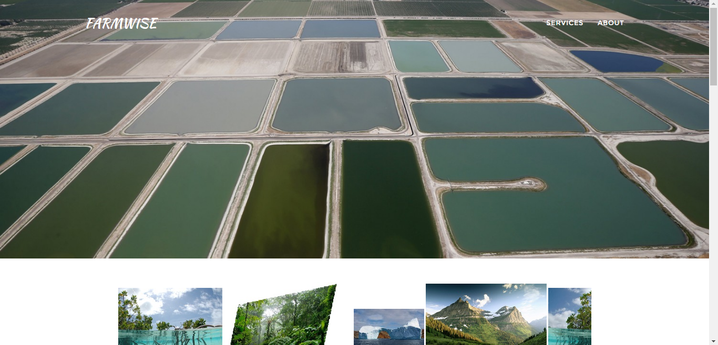

Slide 19
Login Page

Slide 20
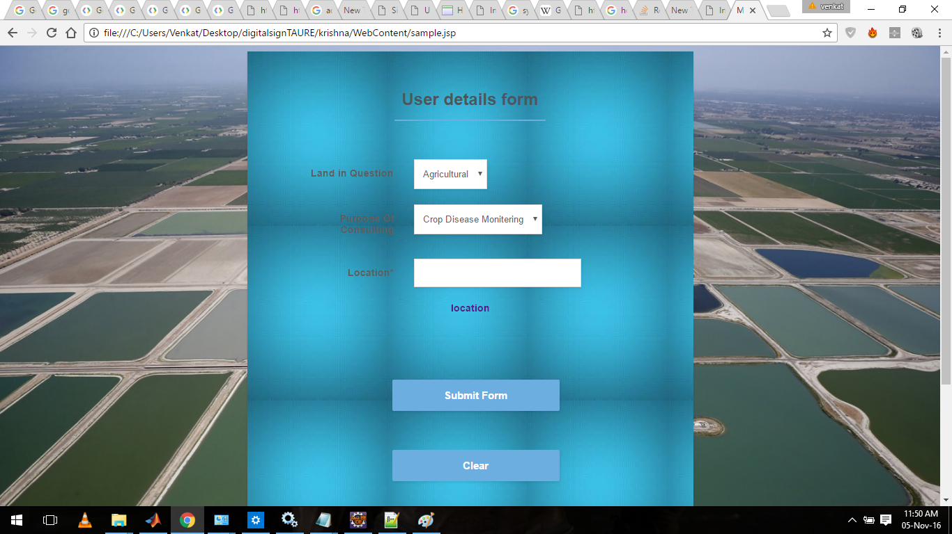

Slide 21
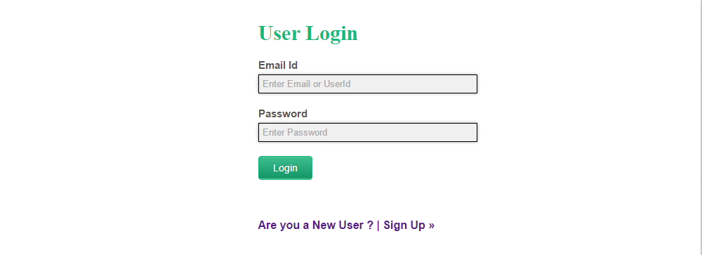
Farmwise Web Page
Used PHP for back-end and HTML ,CSS for front-end.
Login for authorised personnel.

Slide 22
Username :
Password :
Login
Login

Slide 23
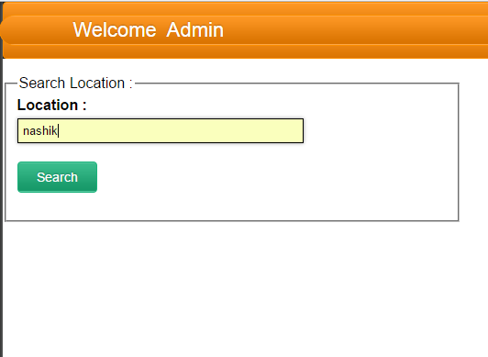
Home Page for Accessing Data
Here , admin will give the location for which the
Data is to be searched and analysed.

Slide 24
Admin Home Page
Location :
Nashik
Search

Slide 25
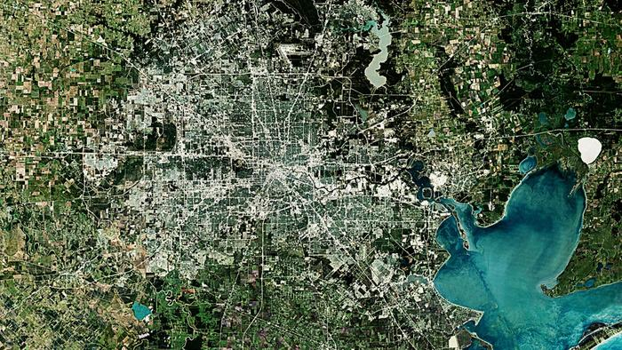
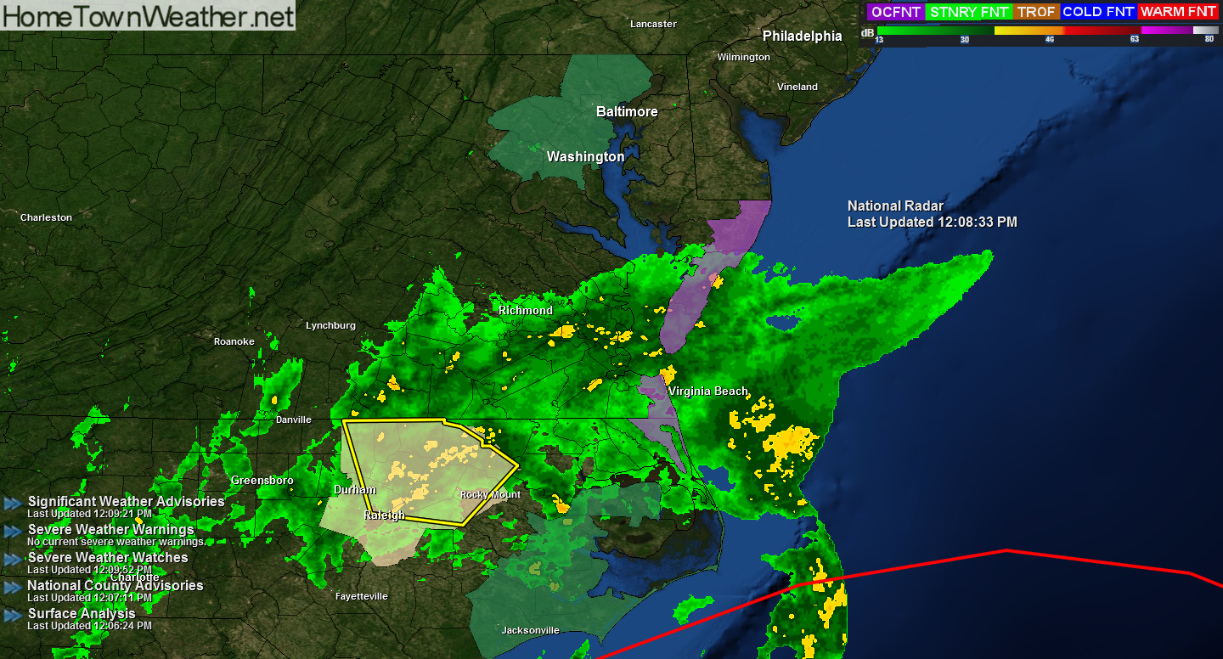
Land Usage for Agriculture :
51.3%
Barren Land :
13.9%

Slide 26
Business Plan

Slide 27
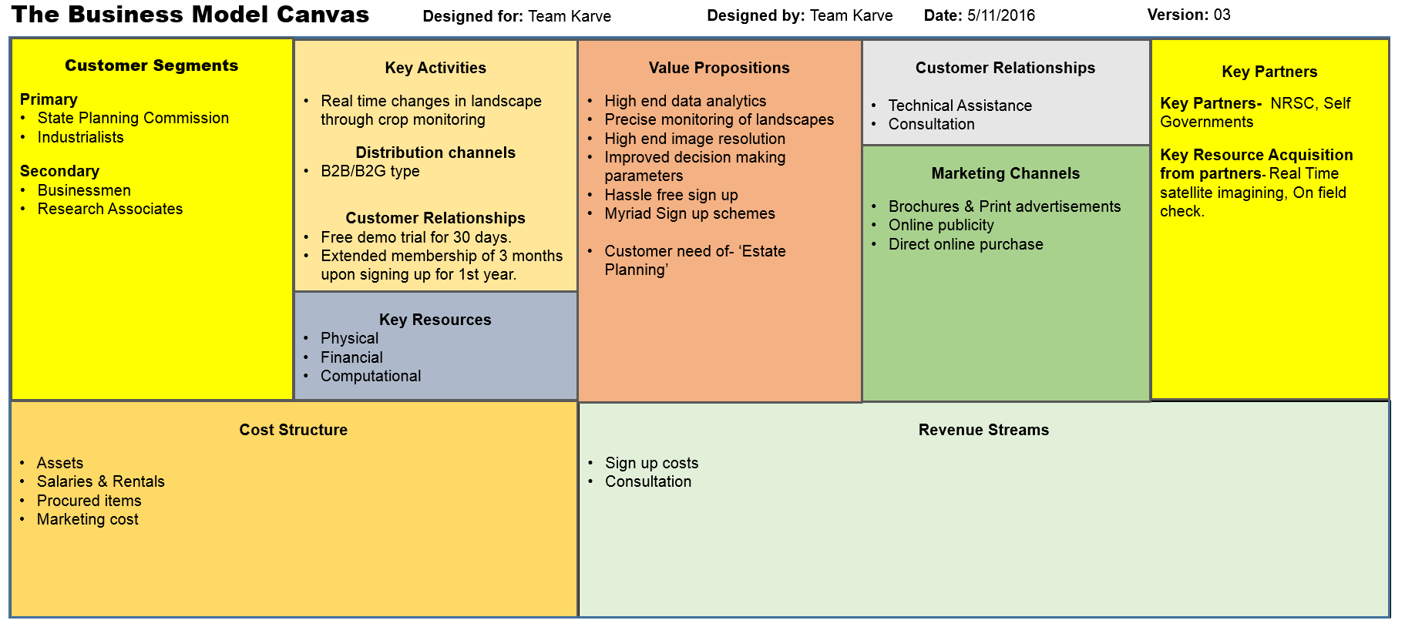

Slide 28
Introduction: FARMWISE
Brief(Team Karve):
Diversified approach to problem solving
Tech savy team
Young & Enthusiatic
USP:
Consolidated data acquisition
Attractive offers for services
Affordable pricing through specific outlook
Mission:
Our mission is to address the disparity prevailing in the agricultural sector and help solve them using remote-sensing technologies.
Vision:
Relation: We listen, learn and help selflessly in our interactions with others.
Humanity: Through business we foster a strong sense of Corporate Social Responsibility.
Commitment: We value our words and act with responsibility.

Slide 29
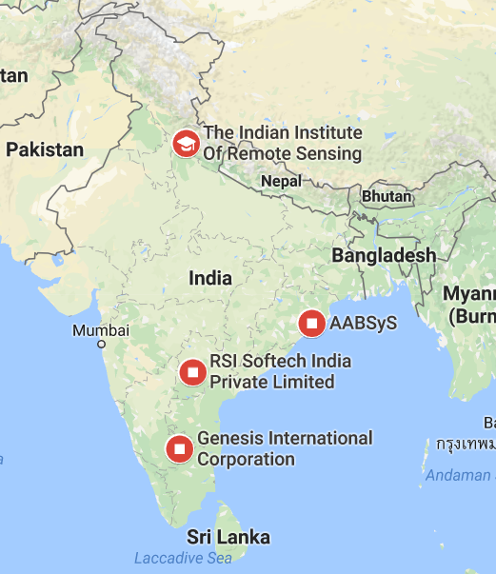
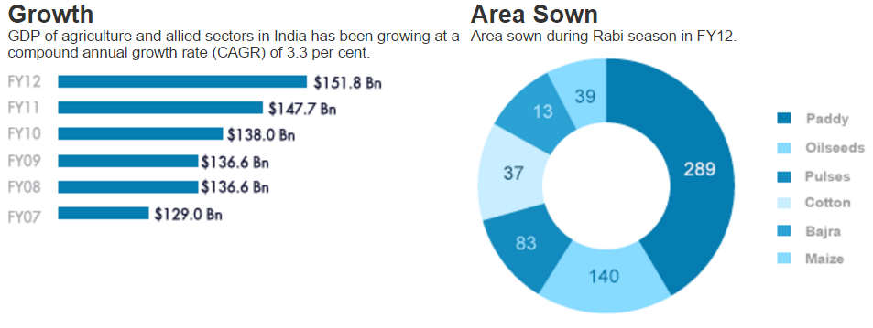
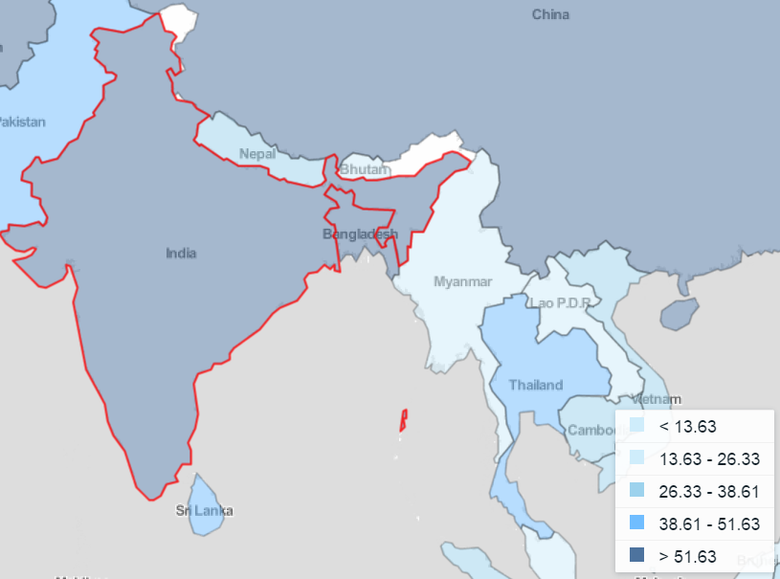
Market Survey
Government organizations are our primary customers
Agricultural industry has seen a rise of over 3.3% in the FY12
(Fig.2. Major Competitors in India)
(Fig.1 Agricultural Growth rate in the recent times)
(Fig.1 Agricultural land usage amounted to nearly 60.3% in 2013 (The World Bank))

Slide 30
SWOT Analysis
Strength
Young & Enthusiastic team
Use of advanced analysis software
Economical product cost
Weakness
Low reputation in market
High dependability on government generated data
Opportunity
Growing market
Rise in living standards
Round the year operation
Threats
Well set market players
Non compliance of government organizations

Slide 31
The Operations Plan
The Operations and Management will be carried out by setting up our work centre at Nashik, Maharashtra owing to the mutual compliance between the firm and the Nashik Municipal Government.
Other notable points include:
Financial and other aids
Land availability
Community attitude
Easy access to marketing centres, banks & post offices
Housing facilities
Security

Slide 32
The Operations Plan
Organizational Structure
Legal Approvals
Managing Director
Marketing Intern
Engineer

Slide 33
The Contingency Planning
Parameters | Problems | Measures
Personal | Internal Fraud | Account auditing every 3 months
 | Partner leaves | A backup engineer
Technical | Server Breakdown | Back up generator
 | Erroneous results | Field verification of the results on a regular basis
 | Erroneous data | Image mapping before every iteration
Others | Government Non-Compliance | Invite tenders from private players

Slide 34
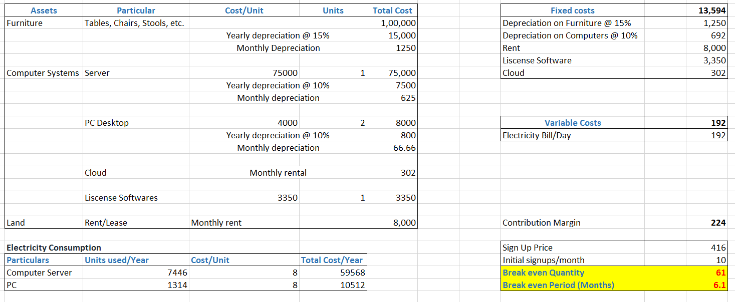
Cost estimation & Break-even period
Break-even is achieved after sported membership of 61 clients.
The time period to achieve this break-even is approximately 6.1 months.

Slide 35
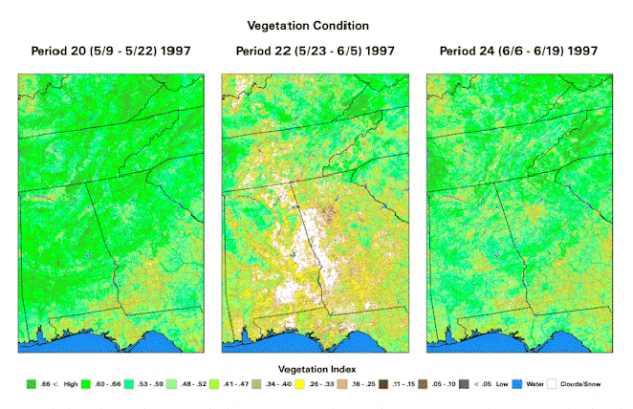
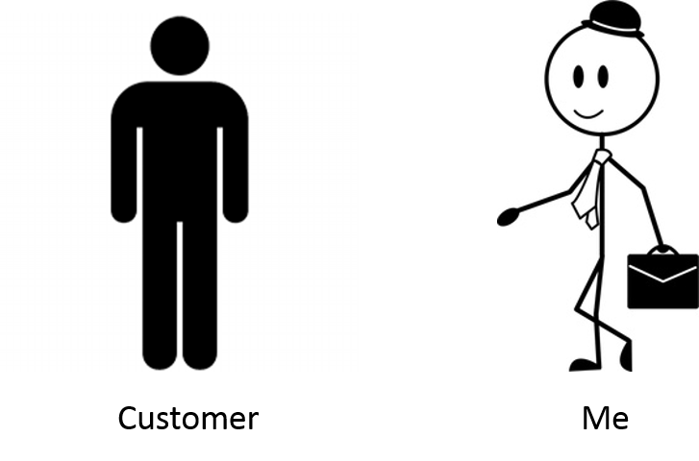



Marketing Strategies
FarmWise
Sugarcane farming earlier
Sugarcane farming now
Better Yield
Happy Farmers
Happy Industrialists
Efficient Governance

Slide 36
Marketing Strategies
Contract:
The customer will claim an annual subscription at only ₹5,000/- (10+2) rather than ₹6,000/- (₹ 500/month). The contract signed would be as follows:
The customer can avail full access to the online database of FarmWise upon signing up as our annual member.
The above contract is valid per unique subscription.

Slide 37
Future Prospects
Finding more potential customers who can use our data
Example: fertilizer and pesticides company Machinery and labour suppliers (for optimized planning )

